Slide 1
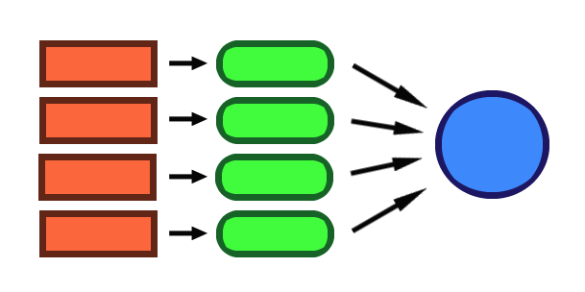
Map/Reduce with Linq & F#

Slide 2
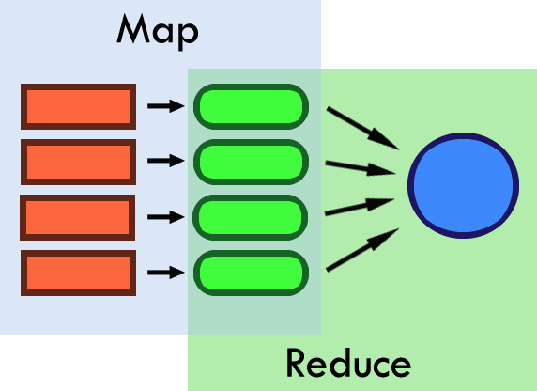
Map/Reduce (.NET 3.5/F#)
(Not to be confused with Google MapReduce)
Map: Convert each item in a list.
Reduce: fold all items down into a single item.

Slide 3
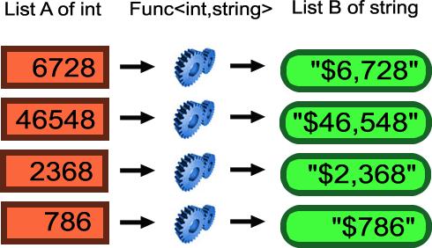
Map, conceptually speaking:
Lazy

Slide 4
Map
Linq
IEnumerable/IQueryable.Select() extension method.
IEnumerable<TResult> Select<TSource, TResult>(
this IEnumerable<TSource> source,
Func<TSource, TResult> selector )
Query syntax
From item In items Select int.Parse(item)
F#
List/Seq.map
(‘a -> ‘b) -> seq<‘a> -> seq<‘b>
Lets see some code!

Slide 5
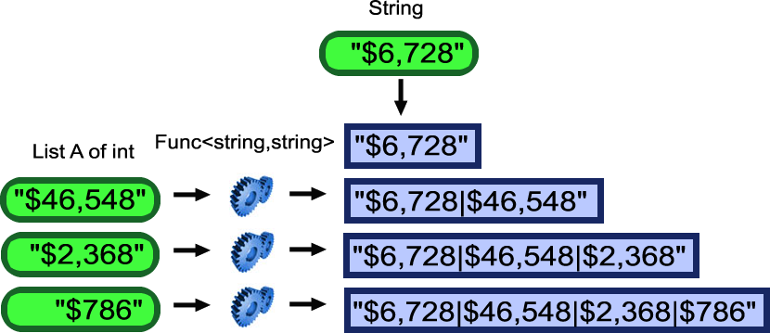
Reduce, conceptually speaking:
Reduce is a type of fold

Slide 6
Reduce
Linq
IEnumerable/IQueryable. Aggregate() extension method.
Aggregate<TSource>(IEnumerable<TSource>, Func<TSource, TSource, TSource>)
F#
List/Seq.reduce
(‘a -> ‘a -> ‘a) -> seq<‘a> -> ‘a
Lets see some code!

Slide 7
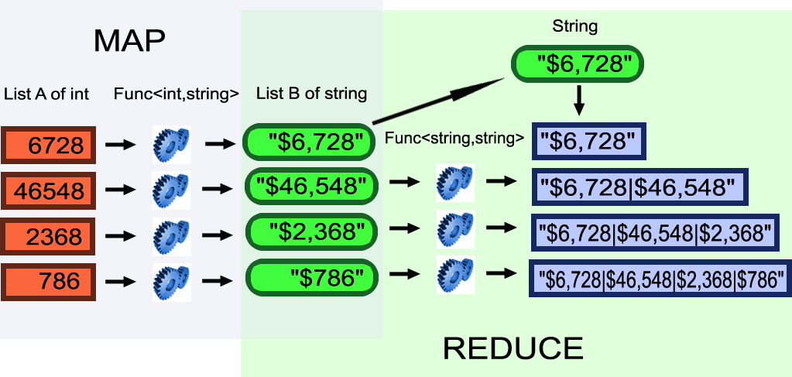
Map/Reduce, conceptually speaking:
Lets see some code…

Slide 8
Thanks!
http://blog.mikeobrien.net

